Slide 1


AI-Powered Collaborative Learning
for JEE Aspirants
Team Devnest
Name of Leader: Mahima Dangi
SISTec Gandhinagar, Bhopal (462036)
Submission date: September 05, 2025
Notes:
1

Slide 2

Competitive Exam Preparation – JEE
JEE: A high-stakes exam for engineering dreams.
Intense competition, vast syllabus, constant pressure.
The need for smarter study tools is critical.
The pressure is real. Students need an "AI buddy" for support and fairness.
Notes:
2

Slide 3


Challenges & Opportunities
1
2
Challenges
Opportunities
Information overload
Centralized knowledge
Language barriers
Inclusivity & accessibility
Isolated learning
Enhanced collaboration
Notes:
3

Slide 4

Preliminary Solution Concept
Introducing CogniCanvas
Study Materials
PDFs, notes, and videos
AI Brain
CogniCanvas: instant, accurate answers
Students
Ask questions and learn
Workspace
Collaborate in real time
Upload study materials, ask questions, get instant, accurate answers from AI.
Notes:
4

Slide 5




Key Features & Functionalities
Personalized Answers
24/7 Assistance
From your uploaded content.
Always available, always ready.
Multilingual Support
Auto-Transcription & Indexing
Hindi + English for wider reach.
Easy content navigation.
Notes:
5

Slide 6
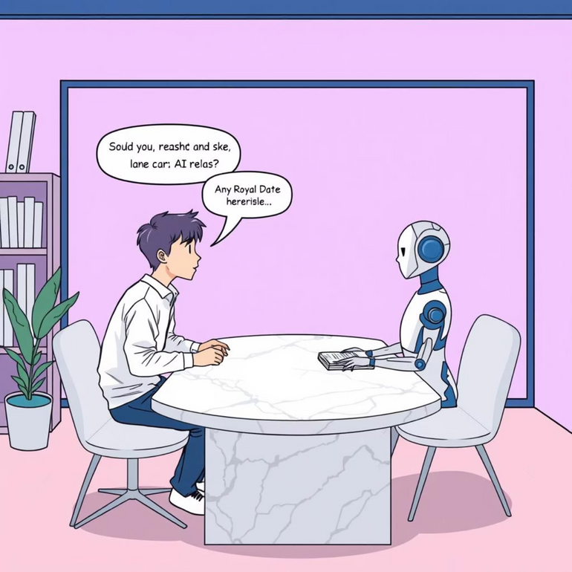
Target Users & Use Cases
Users:
JEE Aspirants
Peer Study Groups
Use Cases:
Individual: Ask AI in Hindi: "Explain torque?" → AI provides explanation + video timestamp.
Group: "Projectile motion formula from Ch-4 PDF?" → AI retrieves instantly for everyone.
Notes:
6

Slide 7

Data Requirements & Privacy
Data Needed:
PDFs, notes, textbooks
Video lectures
Chat logs
Processing:
Vector embeddings (RAG system) for intelligent retrieval.
Privacy Assured:
Encrypted study rooms
No external model training
User-controlled data deletion
Notes:
7

Slide 8

AI Technologies & Methods
Powering CogniCanvas:
User Query
NLP
RAG
Answer
NLP: Understands complex queries.
RAG: Retrieves accurate, context-rich answers.
Speech-to-Text: Voice command input.
Translation: Seamless bilingual support.
Notes:
8

Slide 9
Implementation Approach
01
02
03
Phase 1: Core AI
Phase 2: Frontend
Phase 3: Integration
RAG pipeline with vector database.
Study rooms, chat interface, file uploads.
Voice support, rigorous testing.
A phased approach for robust development and deployment.
Notes:
9

Slide 10
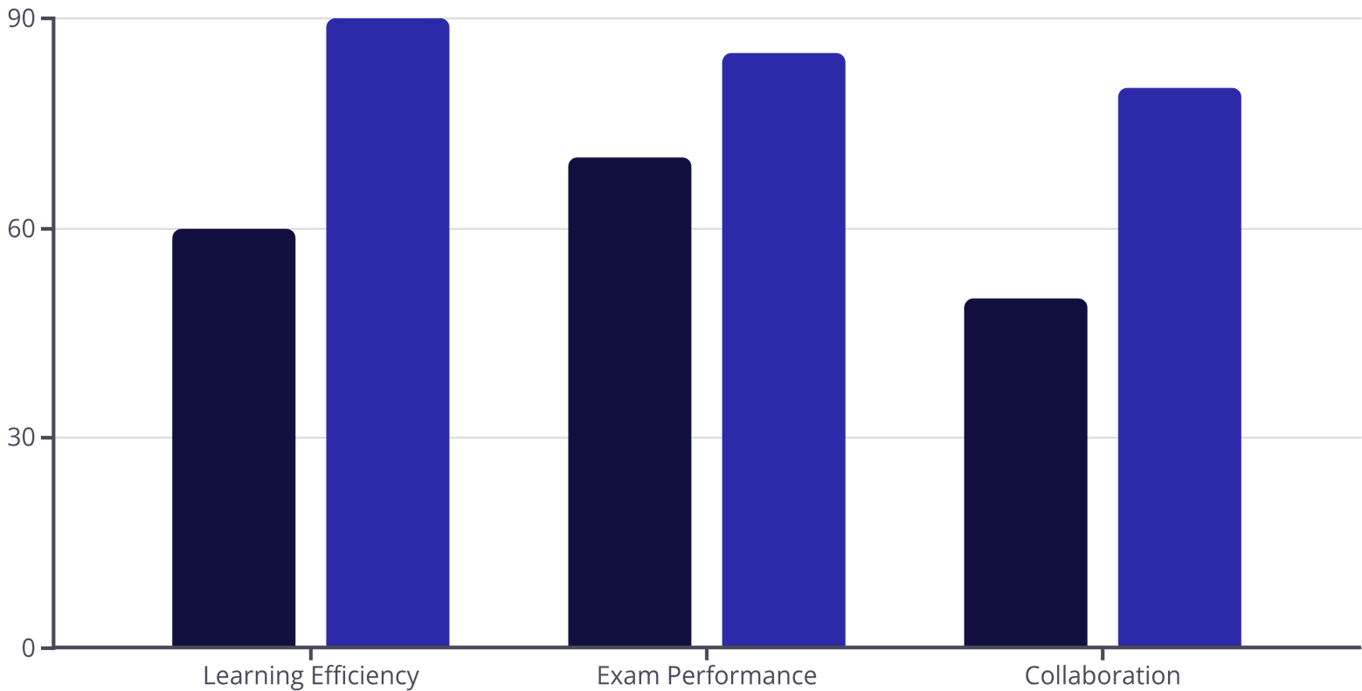
Evaluation Metrics
Measuring Success & Impact:
Before AI (%)
With CogniCanvas (%)
Key Performance Indicators (KPIs):
Response Accuracy, User Engagement (DAU, queries/session)
Bilingual Usage, Task Success Rate
Notes:
10

Slide 11

Thank You!
We appreciate your time and attention.
Notes:
11

